Slide 1

Datamining project
DIABETES PREDICTION
Ngoc Oanh Nguyen

Slide 2

The business reason
Diabetes is a serious chronic disease - reduce quality of life & life expectancy
The most prevalent –130 million adults
The most expensive - $1 out of every $4 in US healthcare costs
No cure → Early diagnosis
Type II
Predict - a patient does or does not have type II diabetes disease
→ $237 billion on direct medical costs & $90 billion on reduced productivity
Age, education, income, location, race, and other social determinants of health

Slide 3
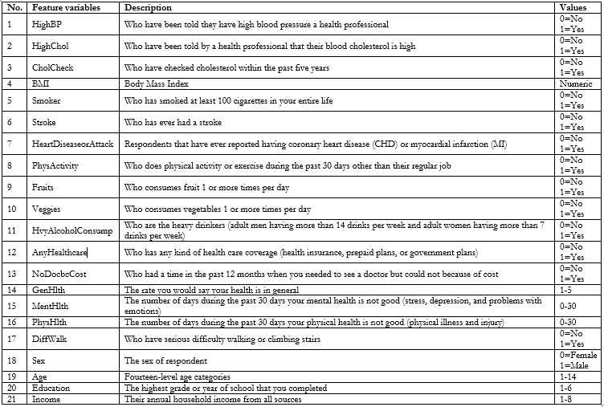
DATA
Diabetes Health Indicators Dataset
Kaggle.com - Dataset Link
2015 - The Behavioral Risk Factor Surveillance System (BRFSS) - The Centers for Disease Control and Prevention (CDC)
253,680 survey responses
Target variable is “Diabetes_binary” 0 - no diabetes/ 1 – prediabetes/diabetes

Slide 4
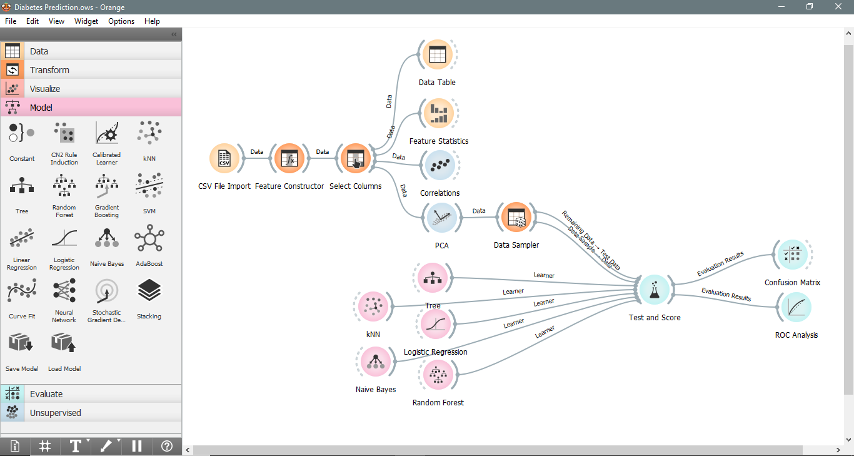
PROCESS

Slide 5
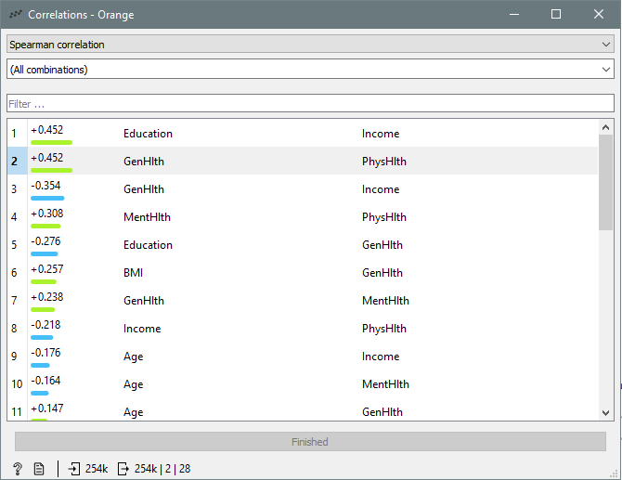
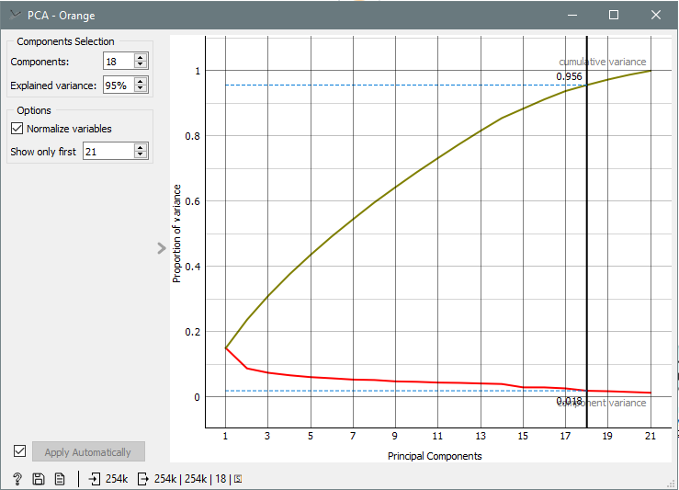
PROCESS

Slide 6
PROCESS

Slide 7
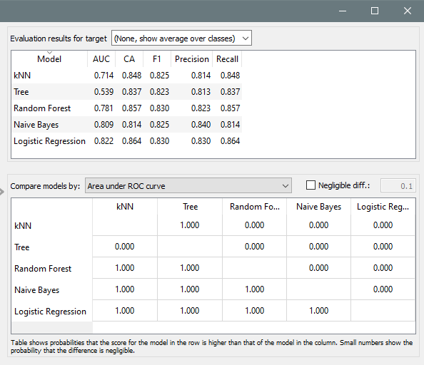
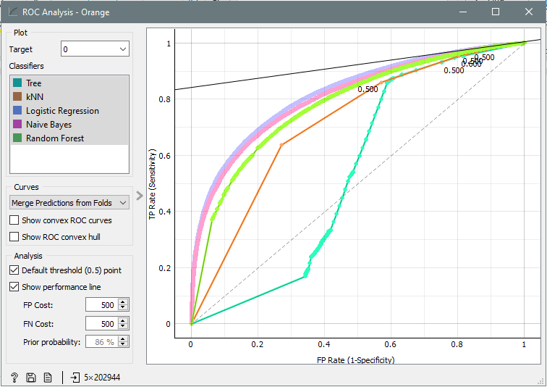
RESULT

Slide 8
the 3 W questions
What Went Well
Clean dataset & no missing values
Orange
Similar
What Did NOT Go Well
Finding a good dataset is time-consuming
My computer crashed a lot of times
What I Would Do Differently Next Time
Explore the data more comprehensively
Detect the outliers
Discretize the Income & Age attributes
Use a different tool with a larger size of dataset
Rich in features and visualizations

Slide 9
THANK YOU FOR YOUR ATTENTION

